Slide 1
Cybersecurity Red-Team Agent with Deep Reinforcement Learning
2025311610 Hoyeon Kim

Slide 2
Cybersecurity Red-Team Agent with Deep Reinforcement Learning
Index
Problem statement
Data/Simulation
Methods
Results
Discussion

Slide 3
Cybersecurity Red-Team Agent with Deep Reinforcement Learning
1. Problem statement
1.1. State
1) Computer Network Graph G = (Node, Edge)
Node: computer machine, Edge: network port
Node | Type | Privilege | Port State
N1 | Linux | LocalUser | PortSSHOpen
N2 | Win10 | Admin | PortSSHOpen
N3 | Win10 | Admin | PortRDPOpen
N4 | Win7 (DB) | System | PortSMBOpen
N1
(Linux)
N4
(Win7)
E4
(SQL)
N4
(DB)
Linux
Win
NoAccess
LocalUser
Admin
System
PortRDPOpen
PortSSHOpen
PortHTTPOpen
PortHTTPsOpen
PortFTPOpen
E1
(SSH)
E3
(SMB)
Edge | Type
E1 | SSH
E2 | RDP
E3 | SMB
E4 | SQL
RDP (Remote Desktop Control)
SSH (Secure Shell)
HTTP/HTTPs
SMB (Server Message Block)
FTP (File Transfer Protocol)
WWI (Windows Management Instrumentation)
N2
(Win10)
N3
(Win10)
E2
(RDP)
Notes:
The hidden states could be represented by Computer Network Graph G.
All nodes are computer machine and they are Linux or Window.
Nodes are connected with Edge and Edge is communication protocol.
It could be SSH, Remote Desktop Protocol, Server Message Block and SQL as example.
Also, they have access privilege and attacker is LocalUser in general.
Attack could access with open port. He should scan the port and find what is open and try to access.

Slide 4
Cybersecurity Red-Team Agent with Deep Reinforcement Learning
1. Problem statement
1.1. State
1) Computer Network Graph G = (Node, Edge)
Node: computer machine, Edge: network port
Node | Type | Privilege | Port State
N1 | Linux | LocalUser | PortSSHOpen
N2 | Win10 | Admin | PortSSHOpen
N3 | Win10 | Admin | PortRDPOpen
N4 | Win7 (DB) | System | PortSMBOpen
N1
(Linux)
N4
(Win7)
E4
(SQL)
N4
(DB)
Linux
Win
NoAccess
LocalUser
Admin
System
PortRDPOpen
PortSSHOpen
PortHTTPOpen
PortHTTPsOpen
PortFTPOpen
E1
(SSH)
E3
(SMB)
Edge | Type
E1 | SSH
E2 | RDP
E3 | SMB
E4 | SQL
RDP (Remote Desktop Control)
SSH (Secure Shell)
HTTP/HTTPs
SMB (Server Message Block)
FTP (File Transfer Protocol)
WWI (Windows Management Instrumentation)
N2
(Win10)
N3
(Win10)
E2
(RDP)
Notes:
The hidden states could be represented by Computer Network Graph G.
All nodes are computer machine and they are Linux or Window.
Nodes are connected with Edge and Edge is communication protocol.
It could be SSH, Remote Desktop Protocol, Server Message Block and SQL as example.
Also, they have access privilege and attacker is LocalUser in general.
Attack could access with open port. He should scan the port and find what is open and try to access.

Slide 5
Cybersecurity Red-Team Agent with Deep Reinforcement Learning
1. Problem statement
1.1. State
2) Vulnerabilities & Attack Primitives
Attacker’s goal is taking over system. (e.g. access DB)
Remote Attack
e.g. Protocol BF → LateralMove
Local Attack
Escalation of Privilege
e.g. UACME → AdminEscalation
N1
(Linux)
N4
(Win7)
E4
(SQL)
N4
(DB)
ID | Node | Vulnerability | Attack Type
V1 | N1(Linux) | SSHBF | Remote
V2 | N1(Linux) | SudoCaching | Local
V3 | N2(Win10) | SSHBF | Remote
V4 | N2(Win10) | UACME43 | Local
V5 | N3(Win10) | RDPBF | Remote
V6 | N3(Win10) | UACME45 | Local
V7 | N4(Win7) | SMBBF | Remote
V8 | N4(Win7) | UACME52 | Local
V9 | N4(Win7) | SQLInjection | Local
E1
(SSH)
E3
(SMB)
N2
(Win10)
N3
(Win10)
E2
(RDP)
Notes:
In the computer network, each computer machine has vulnerabilities.
But it is hidden, so attack should find that and use properly to take over system.
If attacker use remote attack, he could move another nodes.
If attacker use local attack, he could privilege escalation and get access to protect assets.
For example, attack could access DB.

Slide 6
Cybersecurity Red-Team Agent with Deep Reinforcement Learning
1. Problem statement
1.2. Observation & Action
1) Read Team: Attack Scenario
Chain1: SCAN → MOVE N1 → EXPLOIT N1
SCAN node with LocalUser.
MOVE to N1 using SSHBF.
EXPLOIT N1 using SudoCaching.
N1
(Linux)
N4
(Win7)
E4
(SQL)
N4
(DB)
ID | Node | Vulnerability | Attack Type
V1 | N1(Linux) | SSHBF | Remote
V2 | N1(Linux) | SudoCaching | Local
V3 | N2(Win10) | SSHBF | Remote
V4 | N2(Win10) | UACME43 | Local
V5 | N3(Win10) | RDPBF | Remote
V6 | N3(Win10) | UACME45 | Local
V7 | N4(Win7) | SMBBF | Remote
V8 | N4(Win7) | UACME52 | Local
V9 | N4(Win7) | SQLInjection | Local
E1
(SSH)
E3
(SMB)
N2
(Win10)
N3
(Win10)
E2
(RDP)
Notes:
Attacker is local user privilege at first.
He scan the port and find N1 node could access via SSH.
He connect N1 node using SSH and exploit N1 node using SudoCahcing Attack.
Now he is admin privilege.

Slide 7
Cybersecurity Red-Team Agent with Deep Reinforcement Learning
1. Problem statement
1.2. Observation & Action
1) Read Team: Attack Scenario
Chain2: SCAN → MOVE N2 → EXPLOIT N2
SCAN node with Admin.
MOVE to N2 using SSHBF.
EXPLOIT N2 using UACME43.
N1
(Linux)
N4
(Win7)
E4
(SQL)
N4
(DB)
ID | Node | Vulnerability | Attack Type
V1 | N1(Linux) | SSHBF | Remote
V2 | N1(Linux) | SudoCaching | Local
V3 | N2(Win10) | SSHBF | Remote
V4 | N2(Win10) | UACME43 | Local
V5 | N3(Win10) | RDPBF | Remote
V6 | N3(Win10) | UACME45 | Local
V7 | N4(Win7) | SMBBF | Remote
V8 | N4(Win7) | UACME52 | Local
V9 | N4(Win7) | SQLInjection | Local
E1
(SSH)
E3
(SMB)
N2
(Win10)
N3
(Win10)
E2
(RDP)
Notes:
Attacker connect N2 node using SSH and exploit N2 node using UACME43 Attack.

Slide 8
Cybersecurity Red-Team Agent with Deep Reinforcement Learning
1. Problem statement
1.2. Observation & Action
1) Read Team: Attack Scenario
Chain3: SCAN → MOVE N3 → EXPLOIT N3
SCAN node with Admin.
MOVE to N3 using RDPBF.
EXPLOIT N3 using UACME45.
N1
(Linux)
N4
(Win7)
E4
(SQL)
N4
(DB)
ID | Node | Vulnerability | Attack Type
V1 | N1(Linux) | SSHBF | Remote
V2 | N1(Linux) | SudoCaching | Local
V3 | N2(Win10) | SSHBF | Remote
V4 | N2(Win10) | UACME43 | Local
V5 | N3(Win10) | RDPBF | Remote
V6 | N3(Win10) | UACME45 | Local
V7 | N4(Win7) | SMBBF | Remote
V8 | N4(Win7) | UACME52 | Local
V9 | N4(Win7) | SQLInjection | Local
E1
(SSH)
E3
(SMB)
N2
(Win10)
N3
(Win10)
E2
(RDP)
Notes:
Attacker connect N3 node using RDPBF and exploit N3 node using UACME45 Attack.

Slide 9
Cybersecurity Red-Team Agent with Deep Reinforcement Learning
1. Problem statement
1.2. Observation & Action
1) Read Team: Attack Scenario
Chain4: SCAN → MOVE N4 → EXPLOIT N4
SCAN node with LocalUser.
MOVE to N4 using SMBBF.
EXPLOIT N4 using UACME52.
N1
(Linux)
N4
(Win7)
E4
(SQL)
N4
(DB)
ID | Node | Vulnerability | Attack Type
V1 | N1(Linux) | SSHBF | Remote
V2 | N1(Linux) | SudoCaching | Local
V3 | N2(Win10) | SSHBF | Remote
V4 | N2(Win10) | UACME43 | Local
V5 | N3(Win10) | RDPBF | Remote
V6 | N3(Win10) | UACME45 | Local
V7 | N4(Win7) | SMBBF | Remote
V8 | N4(Win7) | UACME52 | Local
V9 | N4(Win7) | SQLInjection | Local
E1
(SSH)
E3
(SMB)
N2
(Win10)
N3
(Win10)
E2
(RDP)
Notes:
Attacker connect N4 node using SMBBF and exploit N3 node using UACME52 Attack.

Slide 10
Cybersecurity Red-Team Agent with Deep Reinforcement Learning
1. Problem statement
1.2. Observation & Action
1) Read Team: Attack Scenario
Chain5: Access to DB (SQL Injection)
N4 is exploited. → Attacker could access DB using SQL Injection (Additional Reward)
N1
(Linux)
N4
(Win7)
E4
(SQL)
N4
(DB)
ID | Node | Vulnerability | Attack Type
V1 | N1(Linux) | SSHBF | Remote
V2 | N1(Linux) | SudoCaching | Local
V3 | N2(Win10) | SSHBF | Remote
V4 | N2(Win10) | UACME43 | Local
V5 | N3(Win10) | RDPBF | Remote
V6 | N3(Win10) | UACME45 | Local
V7 | N4(Win7) | SMBBF | Remote
V8 | N4(Win7) | UACME52 | Local
V9 | N4(Win7) | SQLInjection | Local
E1
(SSH)
E3
(SMB)
N2
(Win10)
N3
(Win10)
E2
(RDP)
Notes:
Attacker could access DB using SQL Injection.

Slide 11
Cybersecurity Red-Team Agent with Deep Reinforcement Learning
1. Problem statement
1.2. Observation & Action
2) Blue Team: Defend Scenario
Defend 1: Block Traffic
Block SMB traffic at N4 from N3.
Normal access could be blocked, too.
Attack detection should be preceded.
N1
(Linux)
N4
(Win7)
E4
(SQL)
N4
(DB)
ID | Node | Vulnerability | Attack Type
V1 | N1(Linux) | SSHBF | Remote
V2 | N1(Linux) | SudoCaching | Local
V3 | N2(Win10) | SSHBF | Remote
V4 | N2(Win10) | UACME43 | Local
V5 | N3(Win10) | RDPBF | Remote
V6 | N3(Win10) | UACME45 | Local
V7 | N4(Win7) | SMBBF | Remote
V8 | N4(Win7) | UACME52 | Local
V9 | N4(Win7) | SQLInjection | Local
E1
(SSH)
E3
(SMB)
N2
(Win10)
N3
(Win10)
E2
(RDP)
Notes:
Defender could block traffic at N4 from N3.
However, normal access could be blocked too.
So, defender should block traffic when attack was detected.
For example, defender could detect move action of attacker.

Slide 12
Cybersecurity Red-Team Agent with Deep Reinforcement Learning
1. Problem statement
1.2. Observation & Action
2) Blue Team: Defend Scenario
Defend 2: Reimage Node (Privilege Reset)
Reset privilege at N3.
Attacker could retry Escalation of Privilege, when RDP is not blocked.
Attacker should retry EoP and defender should detect attacker’s RDP packets.
N1
(Linux)
N4
(Win7)
E4
(SQL)
N4
(DB)
ID | Node | Vulnerability | Attack Type
V1 | N1(Linux) | SSHBF | Remote
V2 | N1(Linux) | SudoCaching | Local
V3 | N2(Win10) | SSHBF | Remote
V4 | N2(Win10) | UACME43 | Local
V5 | N3(Win10) | RDPBF | Remote
V6 | N3(Win10) | UACME45 | Local
V7 | N4(Win7) | SMBBF | Remote
V8 | N4(Win7) | UACME52 | Local
V9 | N4(Win7) | SQLInjection | Local
E1
(SSH)
E3
(SMB)
N2
(Win10)
N3
(Win10)
E2
(RDP)
Notes:
Defender could reset privilege of N3.
However, attacker could retry EoP at N3, when RDP is not blocked.
Attacker should retry EoP and defender should detect attacker’s RDP packets.

Slide 13
Cybersecurity Red-Team Agent with Deep Reinforcement Learning
2. Data/Simulation
CyberBattleSim https://github.com/microsoft/CyberBattleSim/tree/main
Network Graph: G(node: machine type, edge: connection protocol)
Vulnerabilities
Simulation does not run any code. Instead, vulnerability is abstractly defining.
Each vulnerability has a pre-defined outcome
A leaked set of credentials.
A leaked reference to another node in the network.
Leaked information about a node (node properties).
Ownership to a node.
Privilege escalation on the node.
Example of remote vulnerabilities
A SharePoint site exposing ssh credentials.
An ssh vulnerability granting access to the machine.
A github project leaking credentials in commit history.
A SharePoint site with file containing SAS token to storage account.
Examples of local vulnerabilities:
Extracting authentication token or credentials from a system cache.
Escalating to SYSTEM privileges.
Escalating to Administrator privileges.
Notes:
I use cyberbattlesim simulator. It contains network graph and vulnerabilities.
Simulation does not run any code. Instead, vulnerability is abstractly defining.

Slide 14
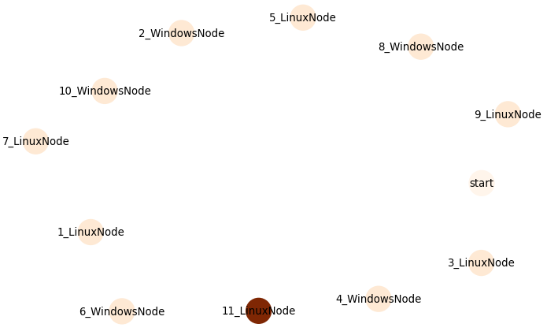
Cybersecurity Red-Team Agent with Deep Reinforcement Learning
3. Method
3.1. Experiment 1: Baseline Attacker Training & Evaluation (Chain Network)
Training and evaluation of five agent types on a randomly generated 11-node chain network.
Random
Rule-Based (Repeat Scan → Move → Exploit)
Deep Q-Learning
Q-Tabular Learning
Deep Recurrent Q-Learning

Slide 15
Cybersecurity Red-Team Agent with Deep Reinforcement Learning
3. Method
3.2. Experiment 2: Transfer Learning Evaluation (Q-Learning on Chain) Train on a small network and evaluate on larger networks to measure generalization.
Train on 4 nodes → evaluate on 10 and 20 nodes.
Train on 10 nodes → evaluate on 20 nodes.
Transfer
Train
Evaluation

Slide 16
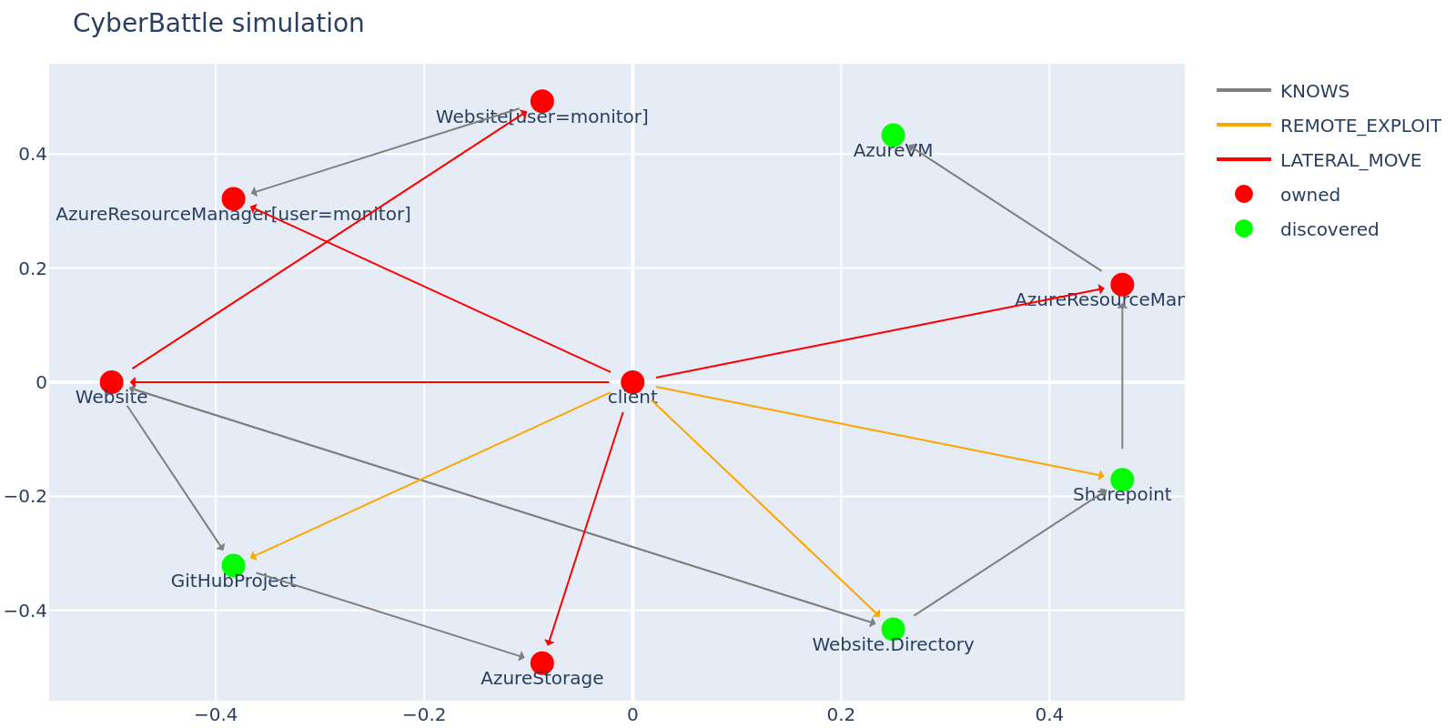
Cybersecurity Red-Team Agent with Deep Reinforcement Learning
3. Method
3.3. Experiment 3: Toy CTF Evaluation (Attacker Agents in Real environment)
Web → GitHub → Storage data exfiltration
Web directory → SharePoint → ARM
Local privilege escalation (Website → monitor) → Azure user credentials

Slide 17
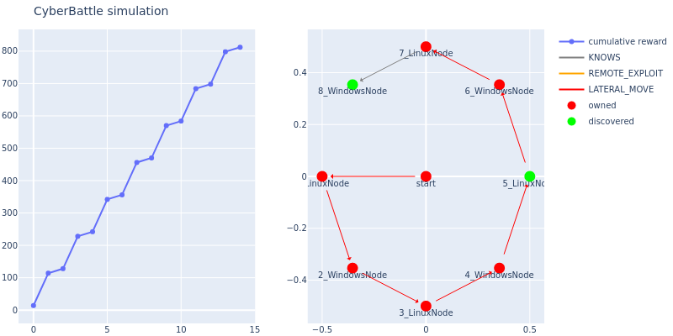
Cybersecurity Red-Team Agent with Deep Reinforcement Learning
3. Method
3.4. Experiment 4: Adding a Defender (Blue Team) and Re-evaluating
Add a defender and retrain and reevaluate all agents.
Defender agent: periodically scans a random subset of nodes and detects the attacker with a fixed probability when the attacker is present.
Recover

Slide 18
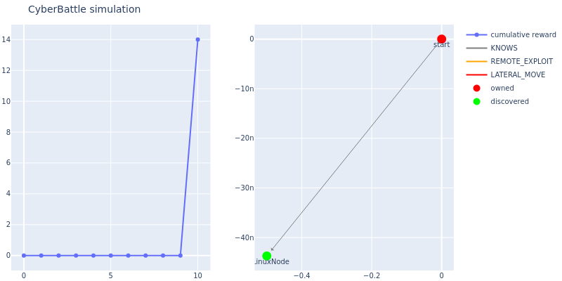
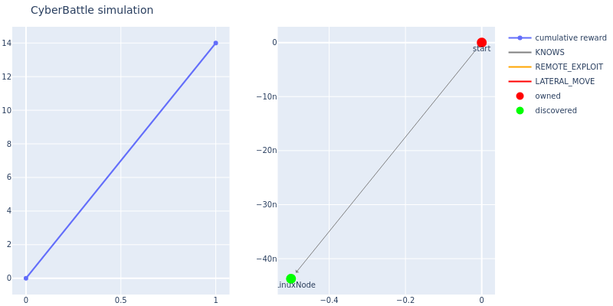
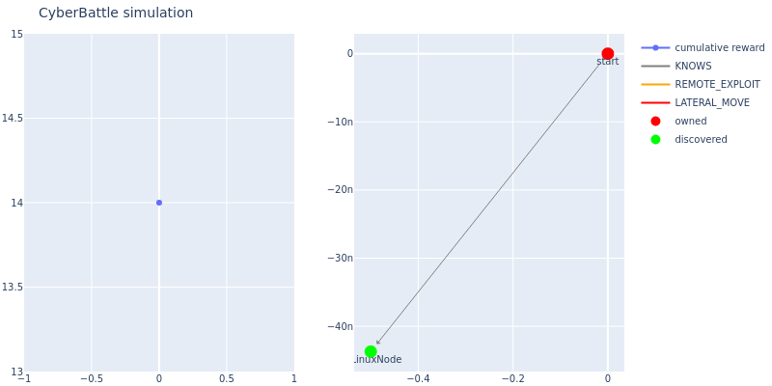
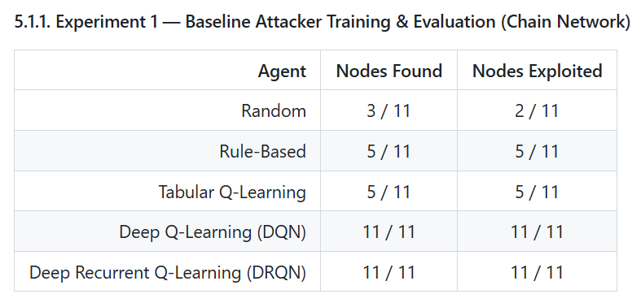
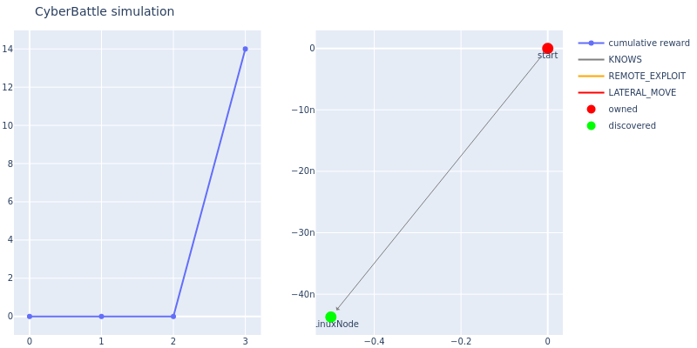
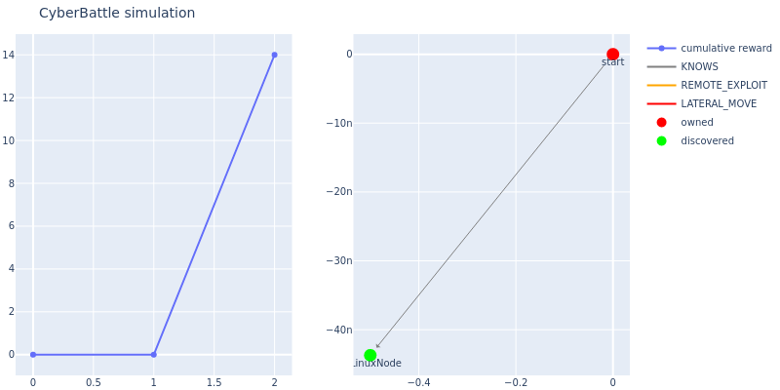
Cybersecurity Red-Team Agent with Deep Reinforcement Learning
4. Results
4.1. Experiment 1: Baseline Attacker Training & Evaluation (Chain Network)
Random
Rule-based
Deep Q-Learning
Tabular Q-Learning
Deep Recurrent Q-Learning

Slide 19
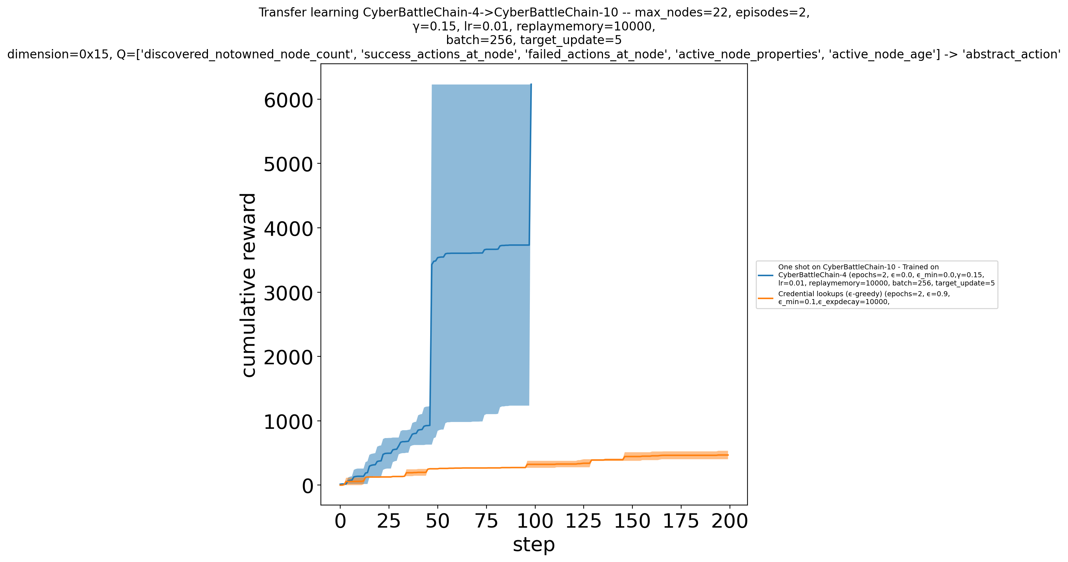
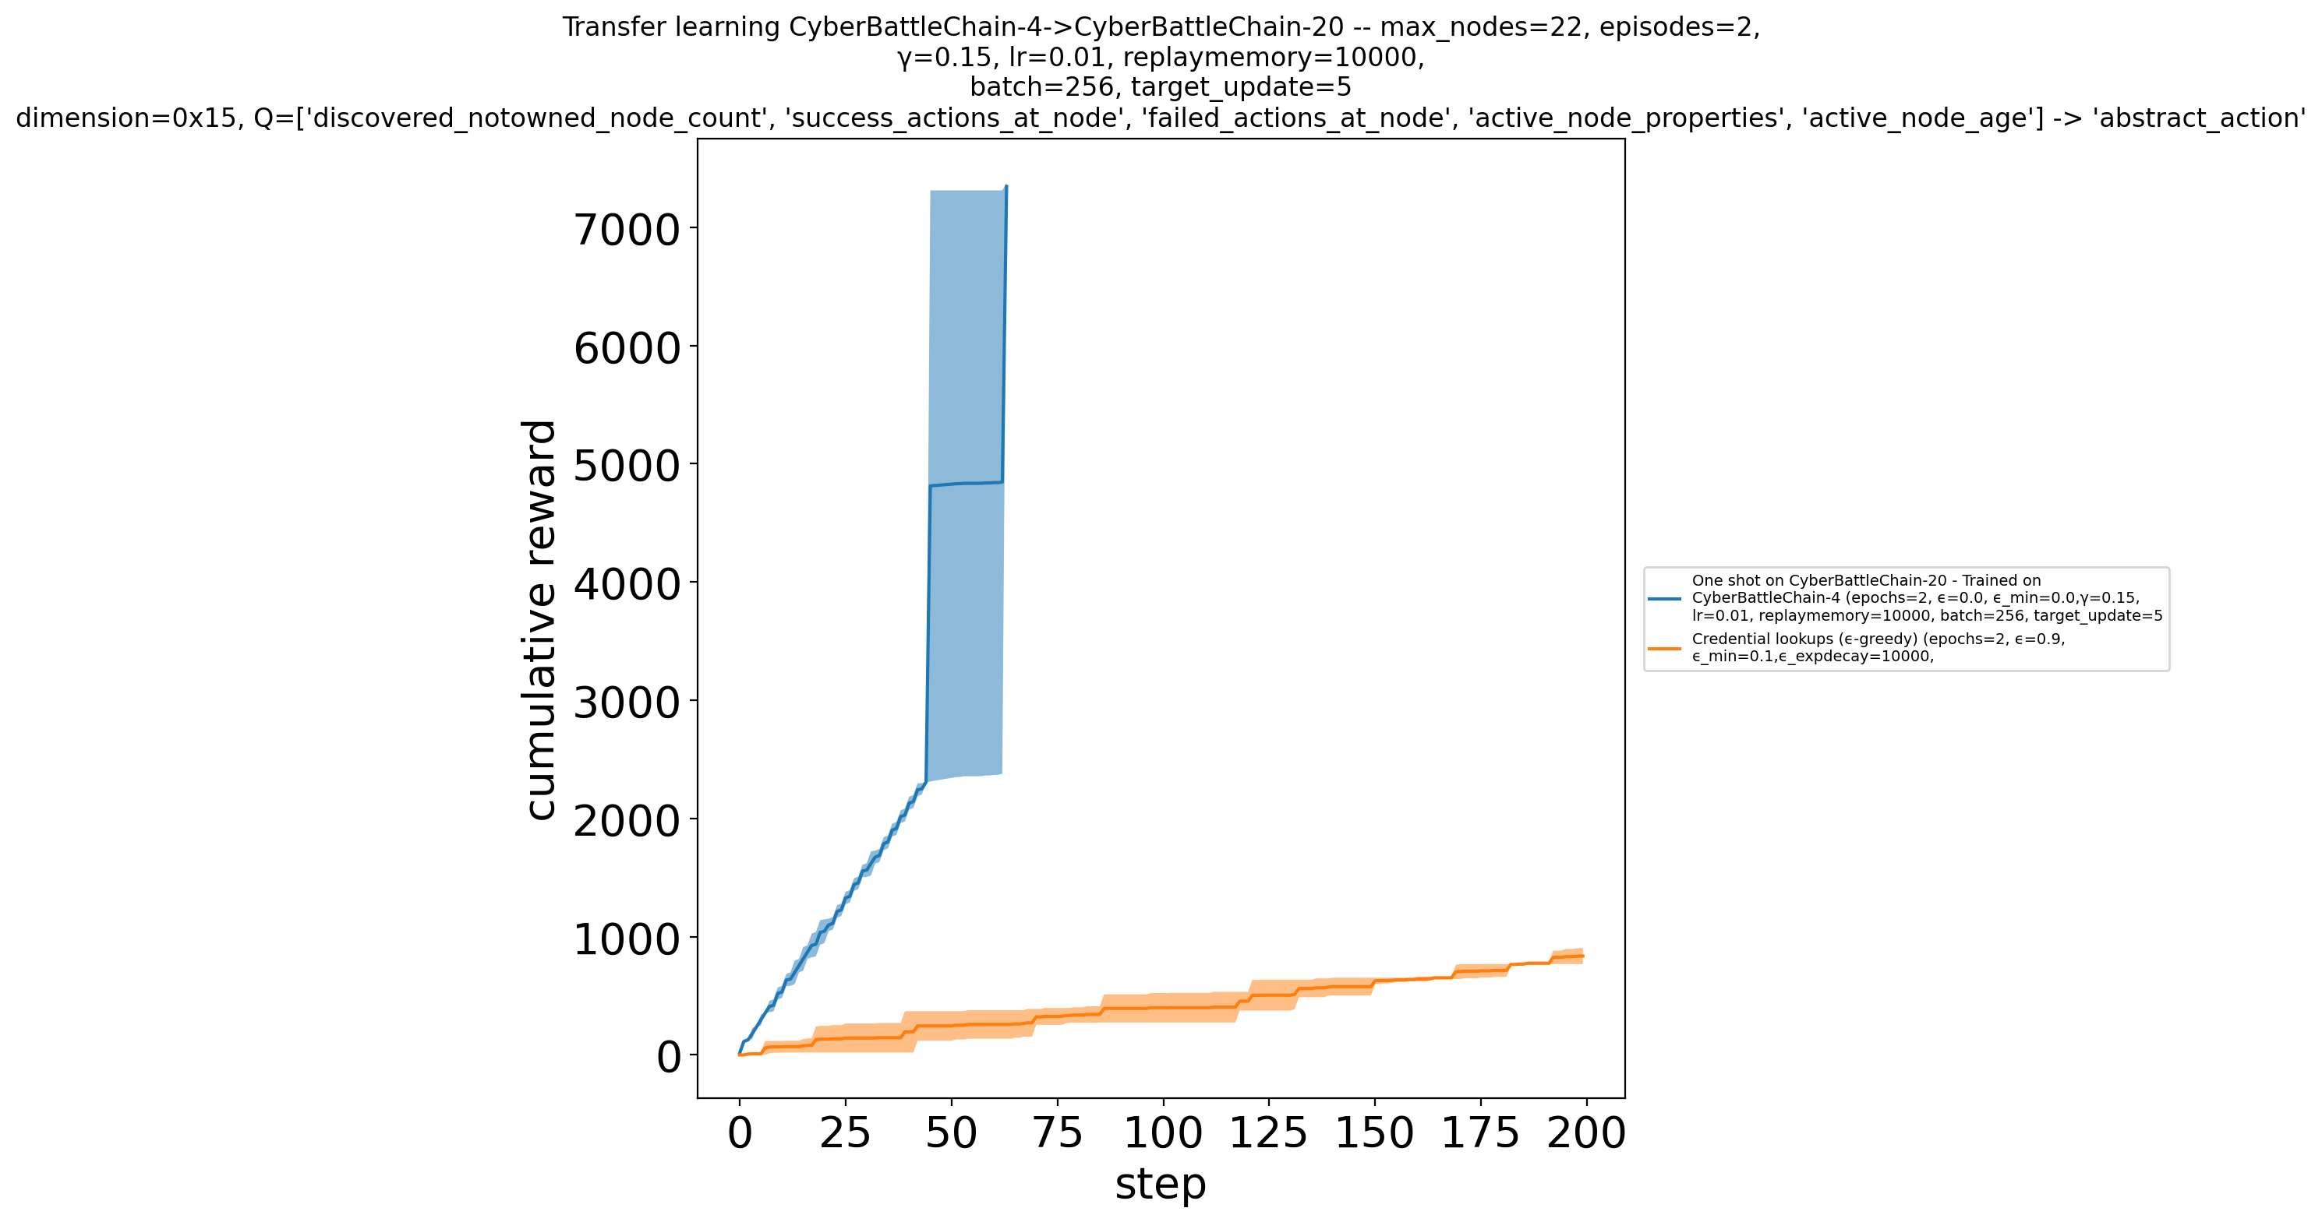
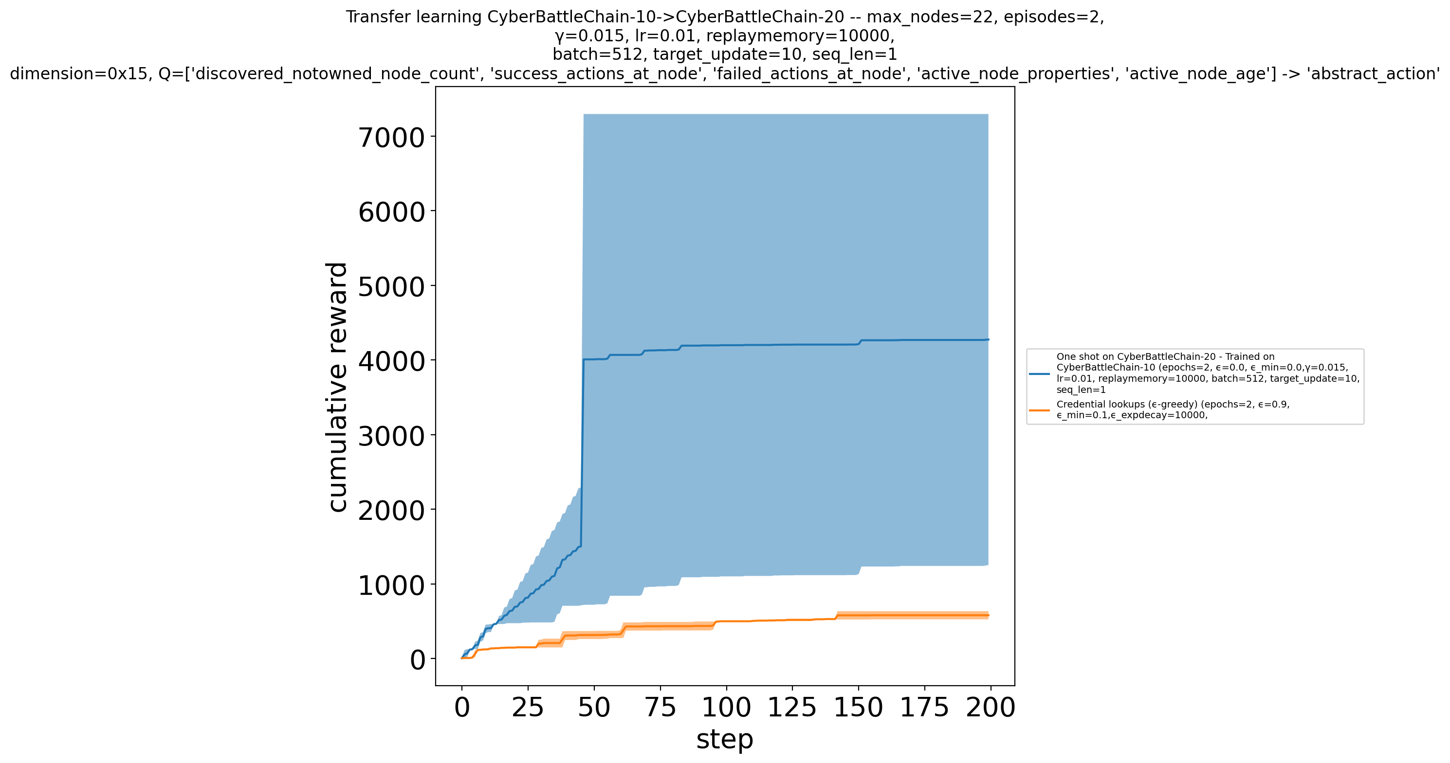
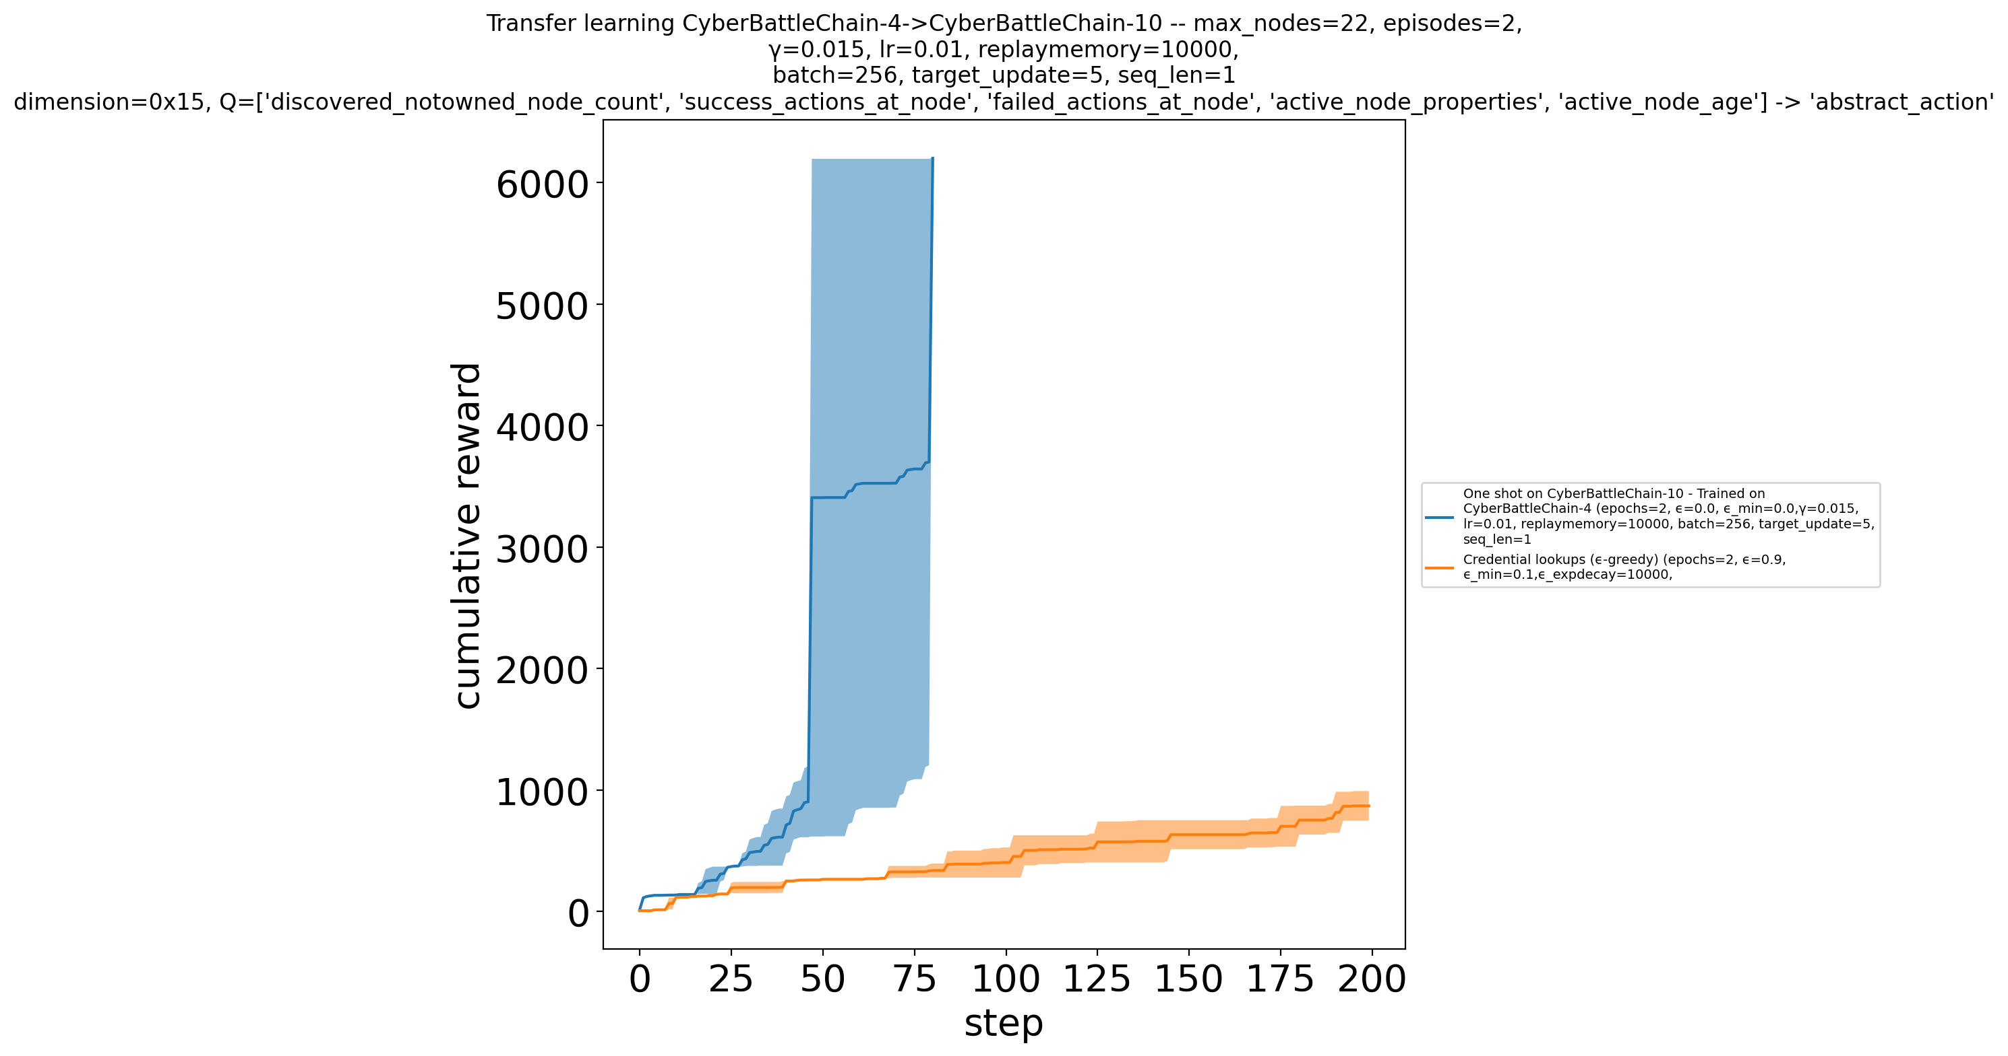
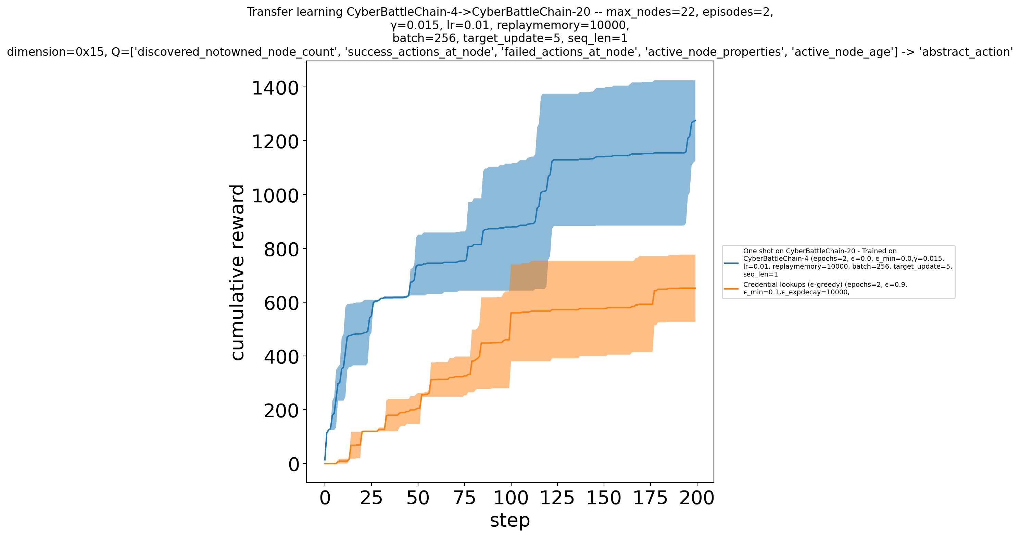
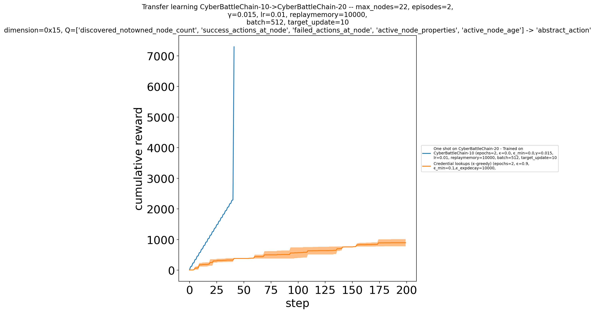
Cybersecurity Red-Team Agent with Deep Reinforcement Learning
4. Results
4.2. Experiment 2: Transfer Learning Evaluation (Q-Learning on Chain)
4 → 10
4 → 20
10 → 20
DQN
DRQN
4 → 10
4 → 20
10 → 20

Slide 20

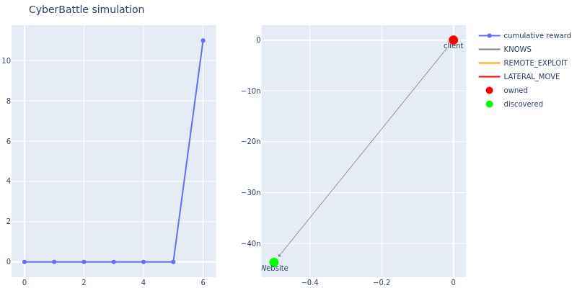
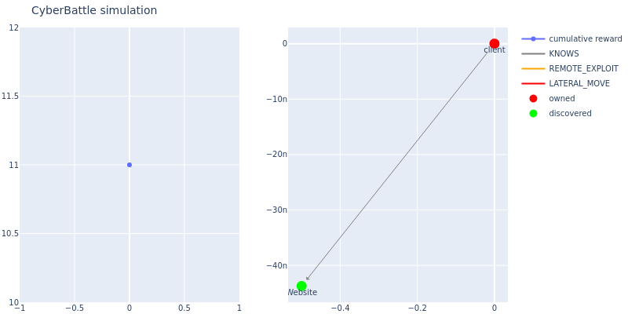
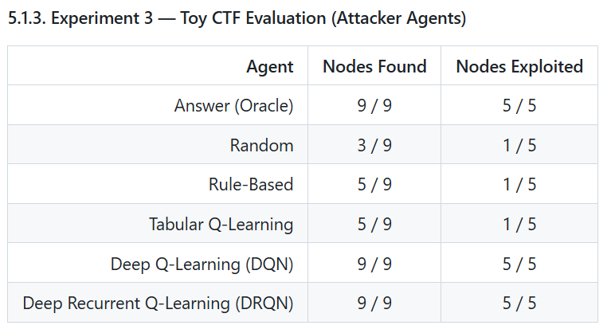
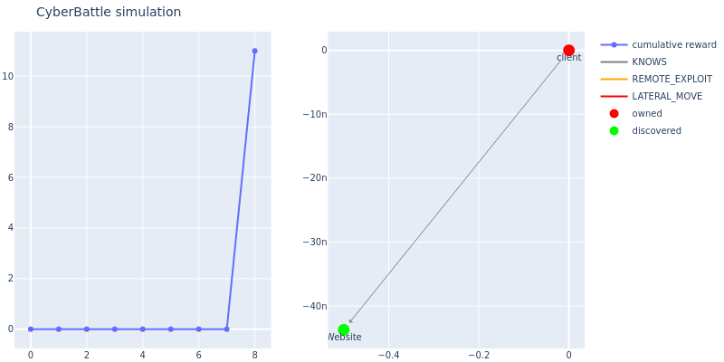
Cybersecurity Red-Team Agent with Deep Reinforcement Learning
4. Results
4.3. Experiment 3: Toy CTF Evaluation (Attacker Agents in Real environment)
Random
Rule-based
Deep Q-Learning
Tabular Q-Learning
Deep Recurrent Q-Learning
Notes:
Physical space

Slide 21
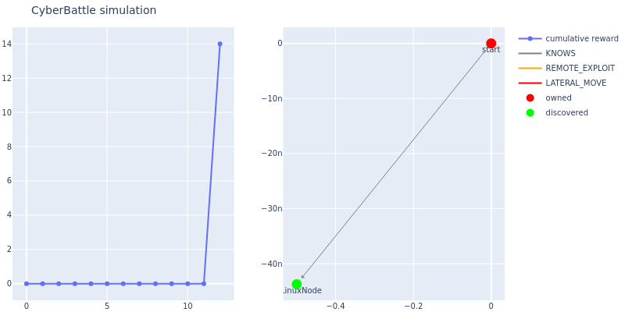
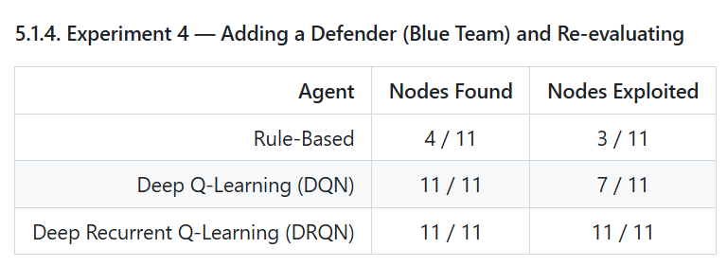
Cybersecurity Red-Team Agent with Deep Reinforcement Learning
4. Results
4.4. Experiment 4: Adding a Defender (Blue Team) and Re-evaluating
Rule-based
Deep Q-Learning
Deep Recurrent Q-Learning
Notes:
Physical space

Slide 22
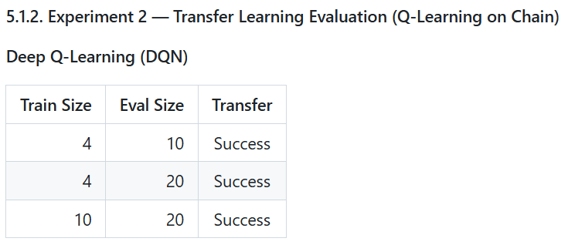
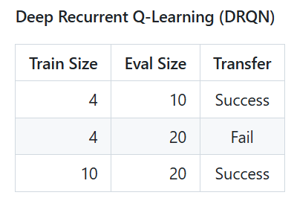
Cybersecurity Red-Team Agent with Deep Reinforcement Learning
5. Discussion
1) Only DQN and DRQN achieve perfect final coverage for all experiments.
→ Deep RL (Reinforcement Learning) is a suitable approach for Red-Teaming.

Slide 23
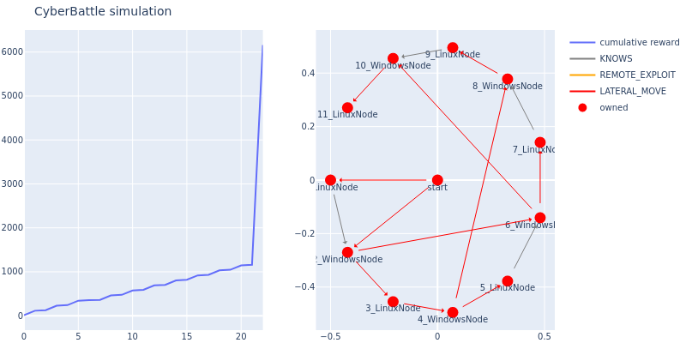
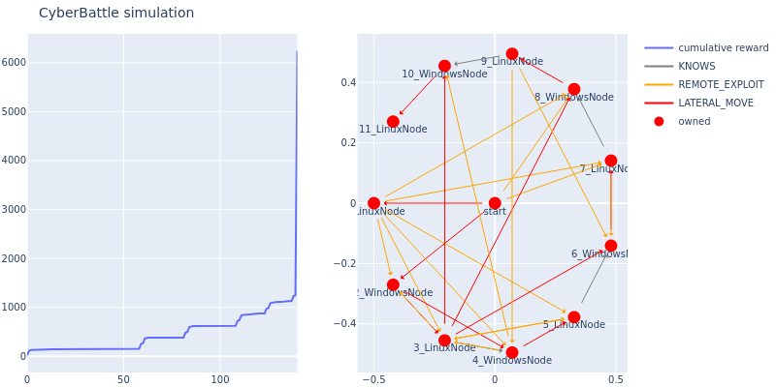
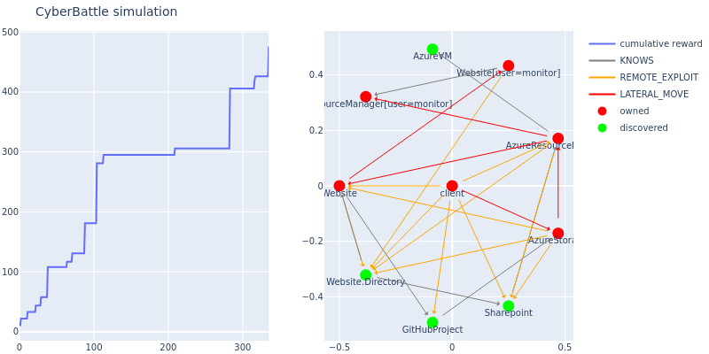
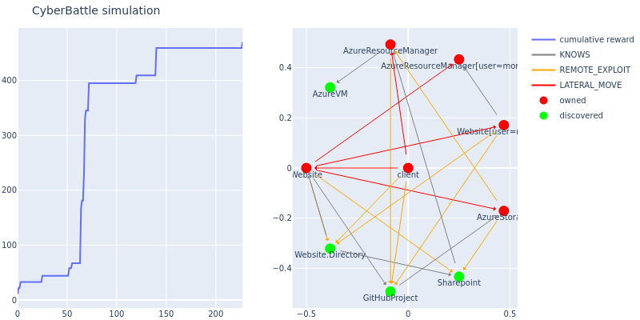
Cybersecurity Red-Team Agent with Deep Reinforcement Learning
5. Discussion
2) DRQN discovers remote attacks and exploits systems faster than DQN.
→ Because its recurrent memory can leverage partial observation history to plan more efficiently.
More Attacks
Fast Exploit
DQN
DRQN

Slide 24
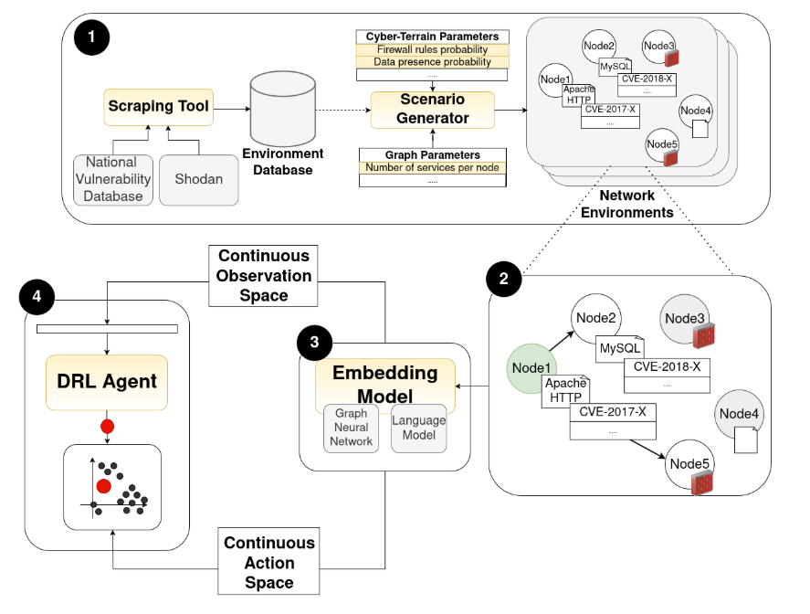
Cybersecurity Red-Team Agent with Deep Reinforcement Learning
5. Discussion
3) Future work: implement a red-team agent in a continuous environment.
ToyCTF does not fully reflect real-world attacks, but many known attacks are documented.
In a discrete action space, increasing # of vulnerabilities rapidly increases the action combination.
→ Making training difficultly.
A CVE-based attack catalog can be used,
but it should be integrated in a scalable way
rather than enumerating every CVE as an individual action.

Slide 25
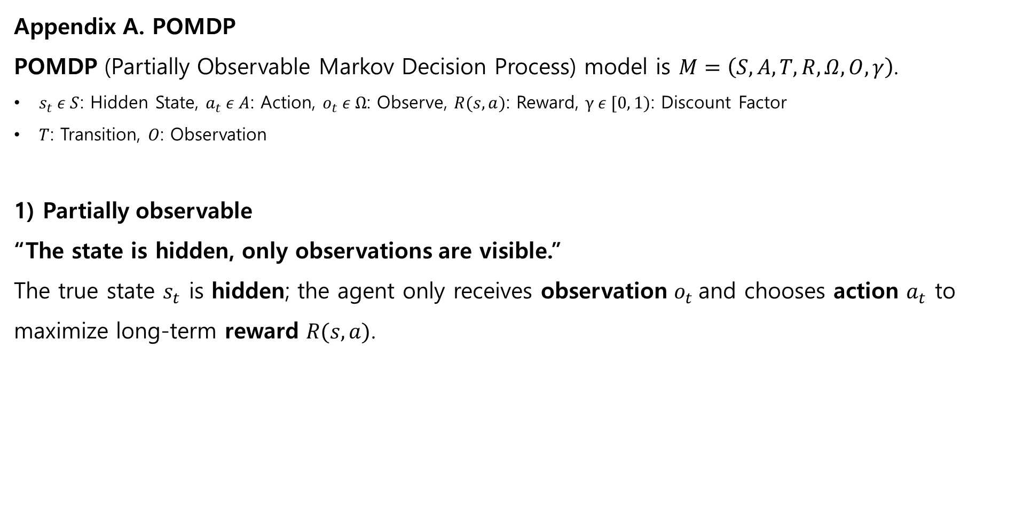
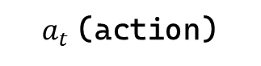
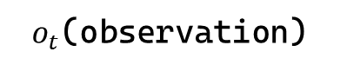
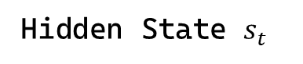
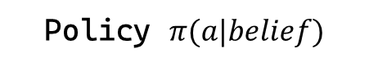
Cybersecurity Red-Team Agent with Deep Reinforcement Learning
Appendix A. POMDP
POMDP (Partially Observable Markov Decision Process) model is $M=\left(S, A, T, R, Ω, O, γ\right)$.
$s_{t} ε S$: Hidden State, $a_{t} ε A$: Action, $o_{t} ε Ω$: Observe, $R(s, a)$: Reward, $γ ε [0, 1)$: Discount Factor
$T$: Transition, $O$: Observation
1) Partially observable
“The state is hidden, only observations are visible.”
The true state $s_{t}$​ is hidden; the agent only receives observation $o_{t}$​and chooses action $a_{t}$ to maximize long-term reward $R(s, a)$.
Environment
Agent
$o_{t}$(observation)
Hidden State $s_{t}$
Policy $π(a|belief)$
$a_{t}$(action)
Notes:
A POMDP (Partially Observable Markov Decision Process) model could be presented by tuple M.
The true state is hidden. The agent only receives observation and chooses action to maximize long-term reward.

Slide 26
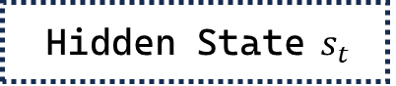
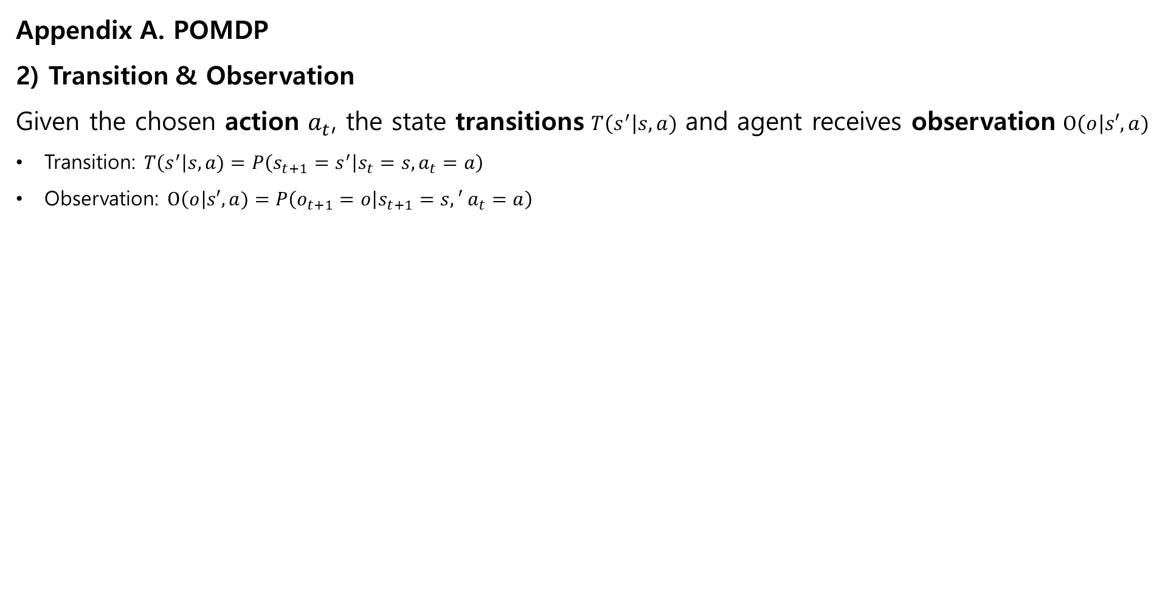

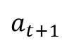

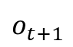
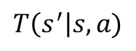
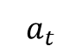
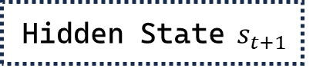
Cybersecurity Red-Team Agent with Deep Reinforcement Learning
Appendix A. POMDP
2) Transition & Observation
Given the chosen action $a_{t}$, the state transitions $T\left(s^{′}\right|s, a)$ and agent receives observation $O\left(o\right|s′, a)$
Transition: $T\left(s^{′}\right|s, a)=P\left(s_{t+1}=s^{′} | s_{t}=s, a_{t}=a\right)$
Observation: $O\left(o\right|s′, a)=P\left(o_{t+1}=o | s_{t+1}=s,′ a_{t}=a\right)$
Environment
Agent
$$o_{t}$$
Hidden State $s_{t}$
Update Belief and
Choose action
$$a_{t}$$
$$T\left(s^{′}\right|s, a)$$
Hidden State $s_{t+1}$
$$o_{t+1}$$
Update Belief and
Choose action
$$a_{t+1}$$
$$o_{t+2}$$
Update Belief and
Choose action
Notes:
When agent do action, the hidden state transitions and agent receives observation from environment.

Slide 27
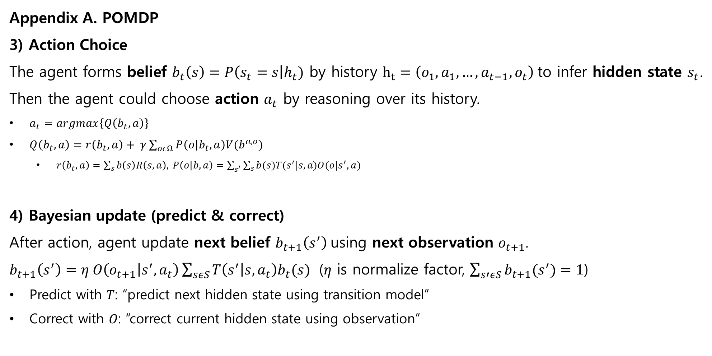
Cybersecurity Red-Team Agent with Deep Reinforcement Learning
Appendix A. POMDP
3) Action Choice
The agent forms belief $b_{t}\left(s\right)=P\left(s_{t}=s\right|h_{t})$ by history $h_{t}=\left(o_{1}, a_{1},…, a_{t−1},o_{t}\right)$to infer hidden state $s_{t}$. Then the agent could choose action $a_{t}$ by reasoning over its history.
$a_{t}=argmax\left\{Q\left(b_{t},a\right)\right\}$
$Q\left(b_{t},a\right)=r\left(b_{t},a\right)+ γ\sum_{oεΩ}{P\left(o | b_{t},a\right)V(b^{a, o})}$
$r\left(b_{t}, a\right)=\sum_{s}{b\left(s\right)R\left(s,a\right), }P\left(o | b,a\right)=\sum_{s^{′}}{\sum_{s}{b(s)T(s^{′}|s,a)O(o|s^{′},a)}}$
4) Bayesian update (predict & correct)
After action, agent update next belief $b_{t+1}\left(s^{′}\right)$using next observation $o_{t+1}$.
$b_{t+1}\left(s^{′}\right)=η O\left(o_{t+1} | s^{′},a_{t}\right)\sum_{sεS}{T\left(s^{′} | s,a_{t}\right)b_{t}(s)}$ ($η$ is normalize factor, $\sum_{s′εS}{b_{t+1}(s^{′})}=1$)
Predict with 𝑇: “predict next hidden state using transition model”
Correct with 𝑂: “correct current hidden state using observation”
Notes:
The agent forms belief by history to infer hidden state.
Then the agent could choose action by reasoning over its history.
After action, agent update next belief using next observation.
POMDP model agent repeat 3)-4) until end condition.

Slide 28
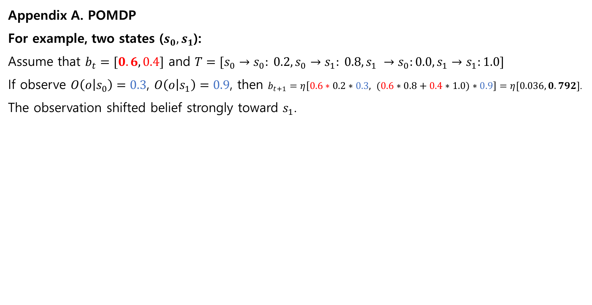
Cybersecurity Red-Team Agent with Deep Reinforcement Learning
Appendix A. POMDP
For example, two states ($s_{0}, s_{1}$):
Assume that $b_{t}=[0.6, 0.4]$​ and $T=[s_{0}→s_{0}: 0.2,s_{0}→s_{1}: 0.8,s_{1} →s_{0}:0.0, s_{1}→s_{1}:1.0]$
If observe $O\left(o | s_{0}\right)=0.3$, $O\left(o | s_{1}\right)=0.9$, then $b_{t+1}=η\left[0.6∗0.2∗0.3, (0.6∗0.8+0.4∗1.0)∗0.9\right]=η[0.036, 0.792]$.
The observation shifted belief strongly toward $s_{1}$.

